Slide 1
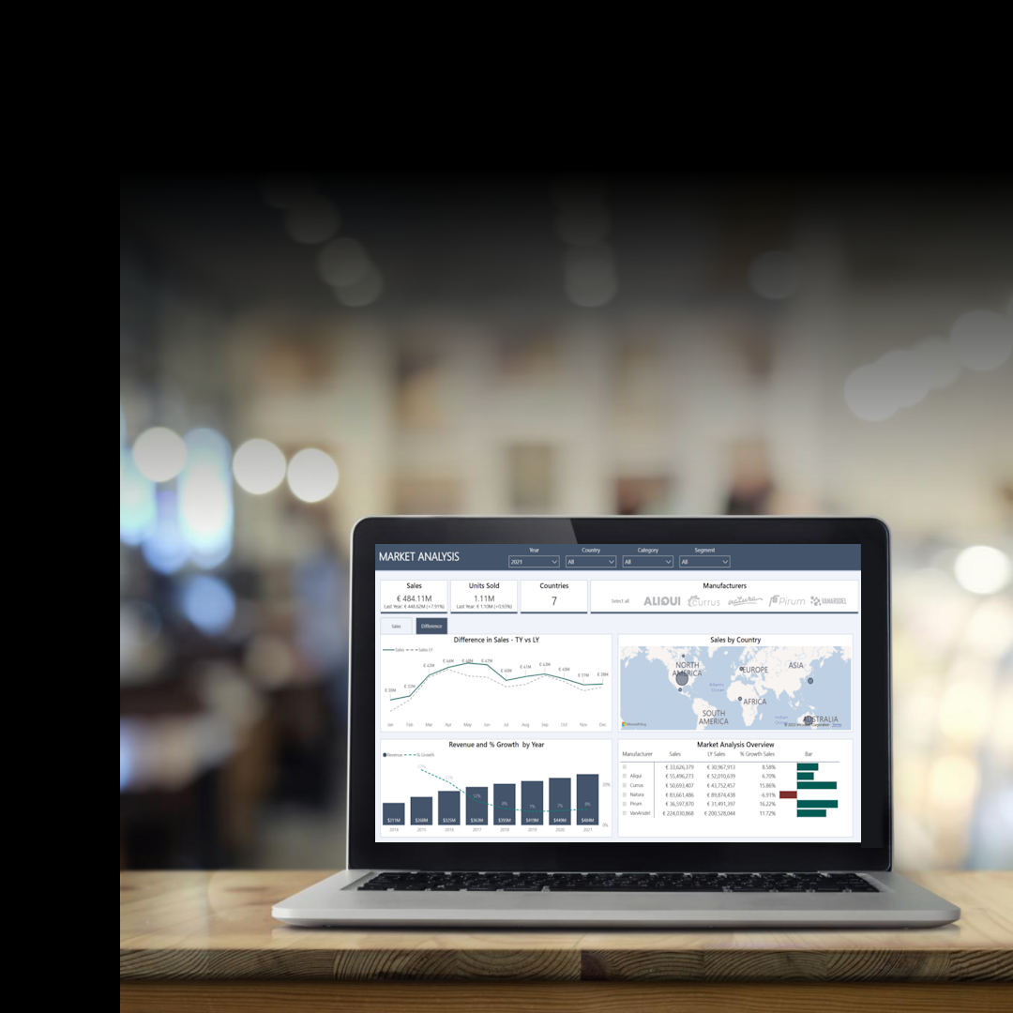


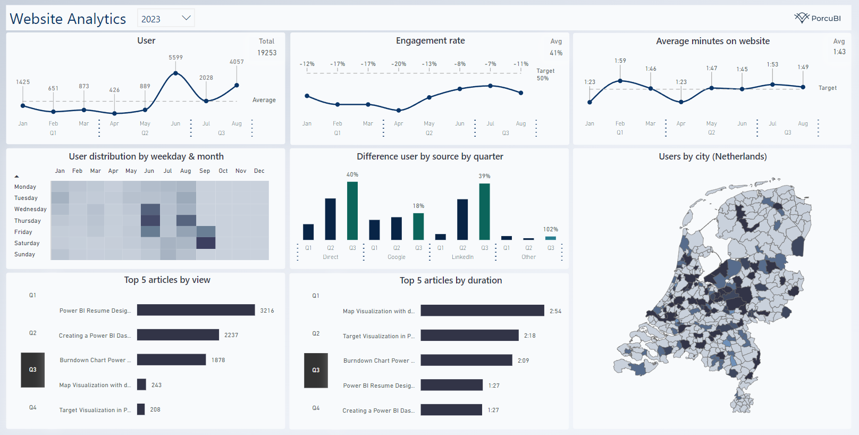
Notes:
Business

Slide 2
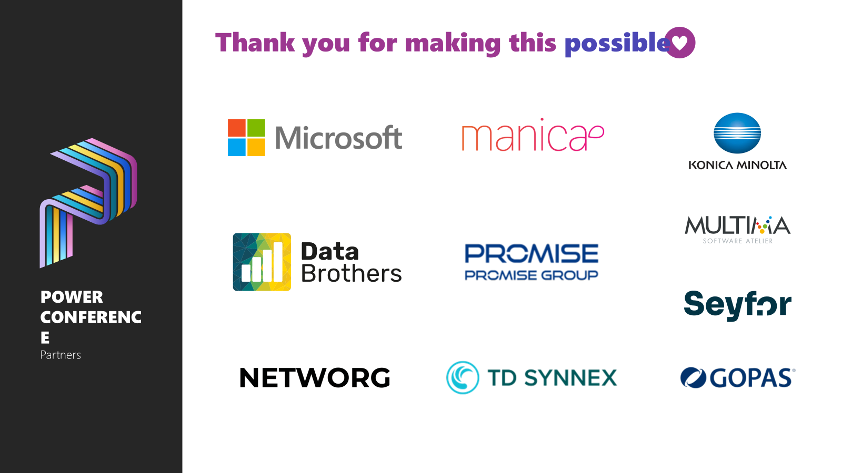

Slide 3

FROM DATA
TO ACTION

Slide 4
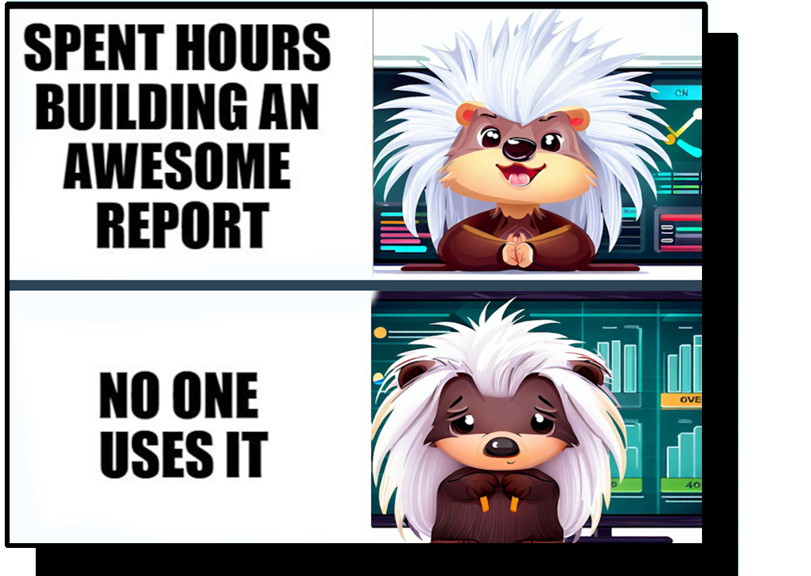
Notes:
Creator

Slide 5





Valerie Junk
PorcuBI
The Netherlands
www.linkedin.com/in/valeriejunk/
porcubi
valeriejunk.bsky.social

Slide 6
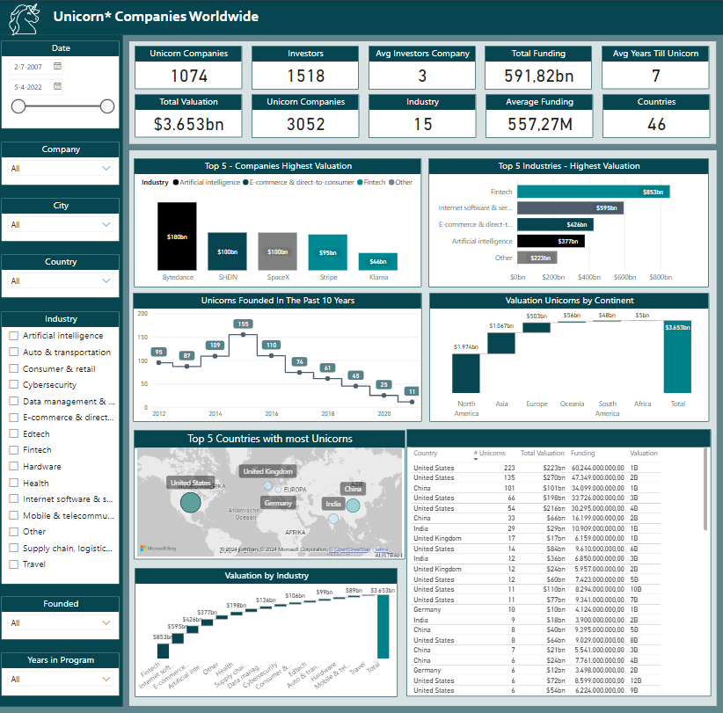
Action-driven design
Guiding the user
Relevance
Usability
You don’t need everything!
Notes:
I think we all, in theory, know what action driven means,,
You don’t need everything. This is not even the worst example but lots of filters, lots of information.. Trying to get all the data
It is okay to have more than 1 report!

Slide 7
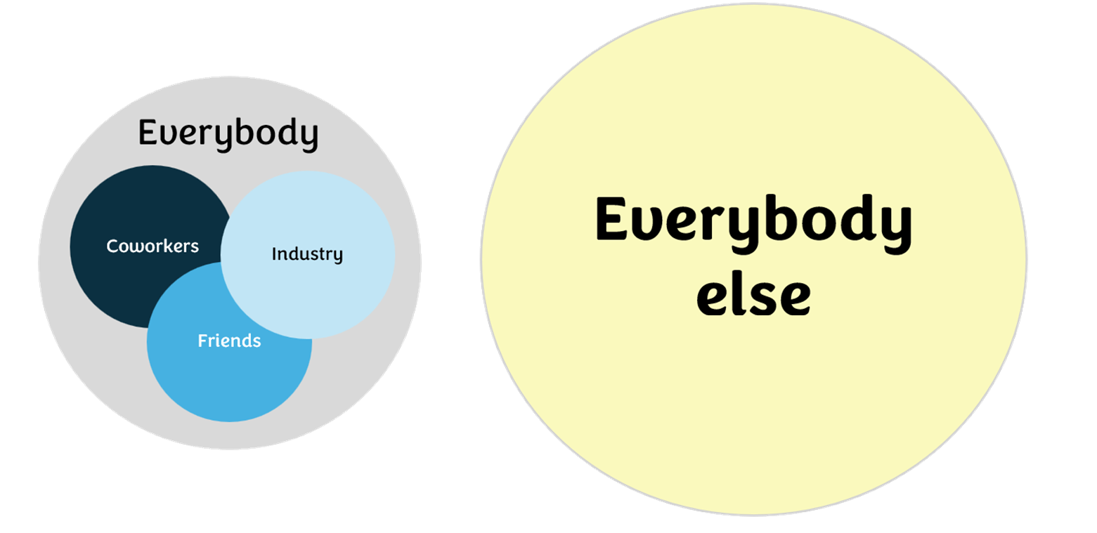
Everybody knows?
Notes:
Internal report design
Assuming that others know what you know and are able to take actions like that

Slide 8

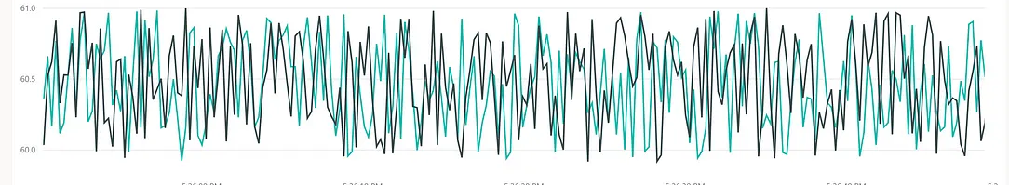
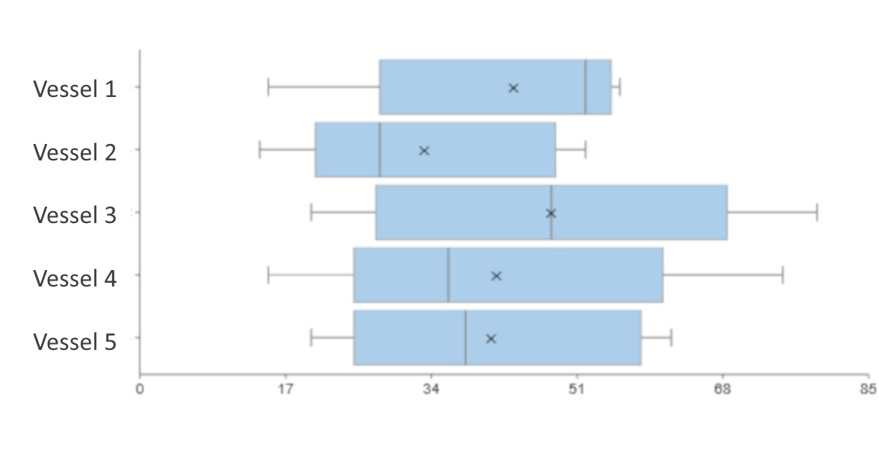
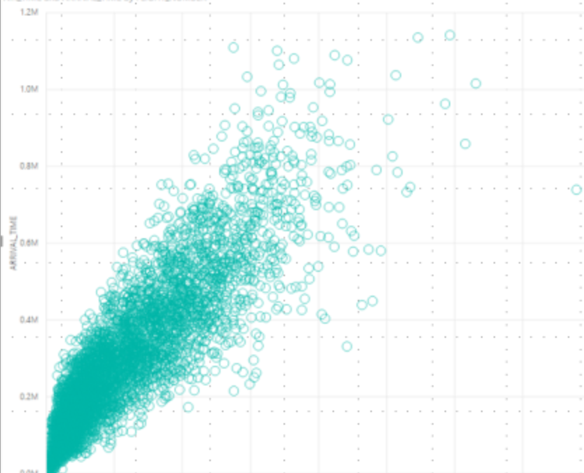
Why care?
Is this good??

Slide 9
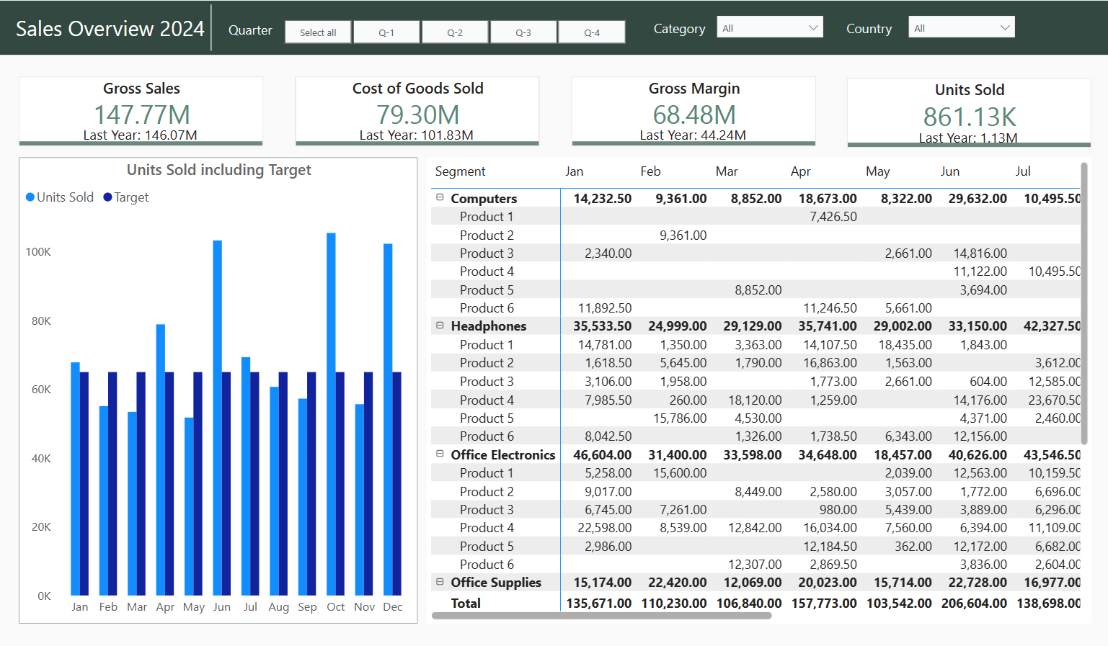
Treasure hunt
The answer is in there (somewhere…)
“Everybody knows this, right?”

Slide 10






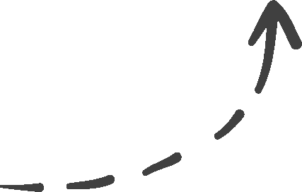
From data to action!
Research
Create
Evaluate
Notes:
Research – Design - Evaluate

Slide 11
Research
Create
Evaluate
Notes:
Research – Design - Evaluate

Slide 12
Research
Who, What & Why?
Notes:
You are not designing for yourself

Slide 13
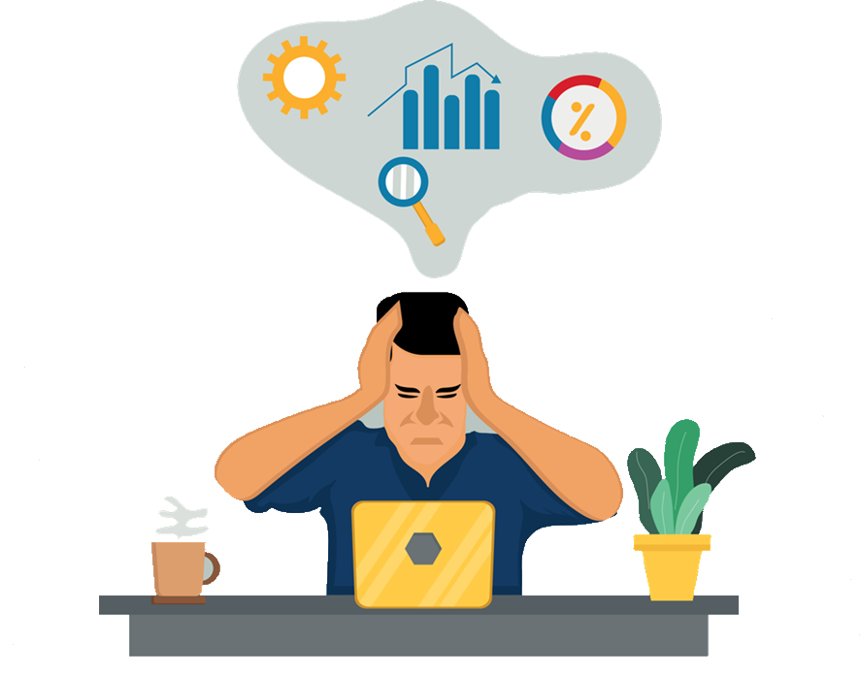
The audience
Who is the audience?
What is the experience level?
What actions do they want to take and why?
What’s the process?
Notes:
You are not designing for yourself

Slide 14
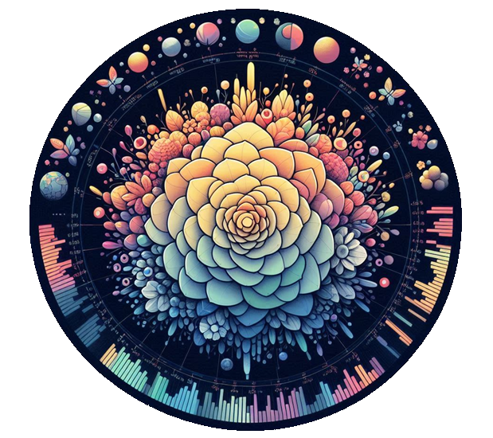
Why do we need to know?
Visual without meaning
=
no purpose.

Slide 15
Design to take the next step
Notes:
So there needs to be something inbetween very pretty but useless and a treasure hunt
Design for insights – when you know the needs of the enduser you can design accordingly

Slide 16
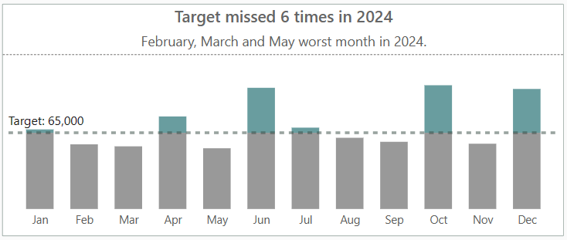
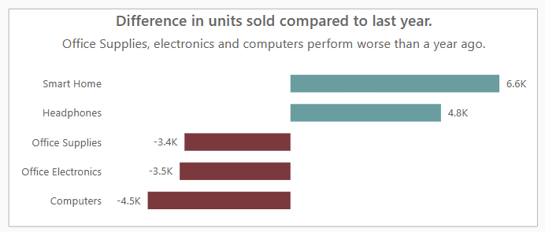
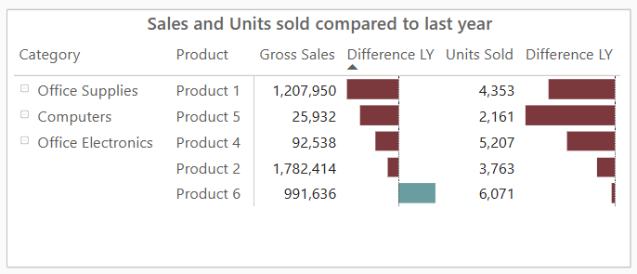
Design to take the next step
Notes:
So there needs to be something inbetween very pretty but useless and a treasure hunt
Design for insights – when you know the needs of the enduser you can design accordingly

Slide 17
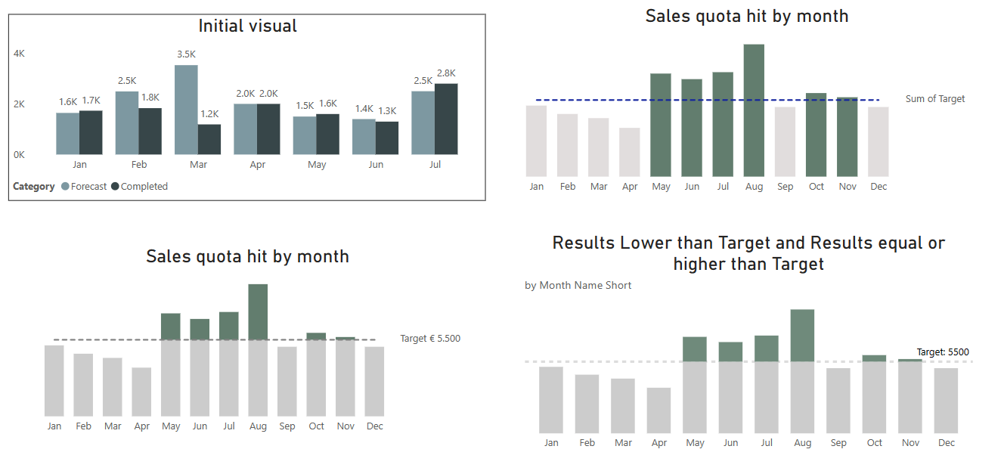
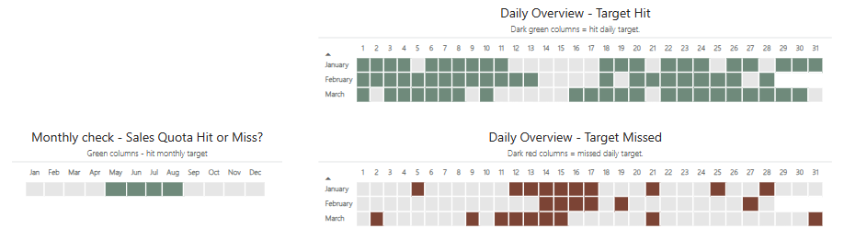
Communication is key
What is the most critical information for you?
Notes:
Don’t stop asking, continuous proces

Slide 18
Design
Context, Simplicity & Relevance
Notes:
You are not designing for yourself

Slide 19
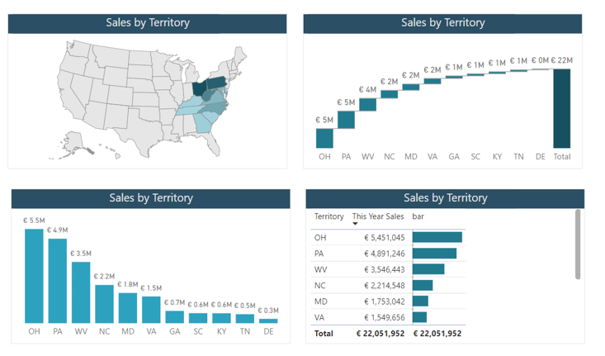
Perfect visual?
I just want an idea of what’s happening.
I like tables but my coworker prefers visuals.
Notes:
Map, waterfall , barchart, matrix

Slide 20
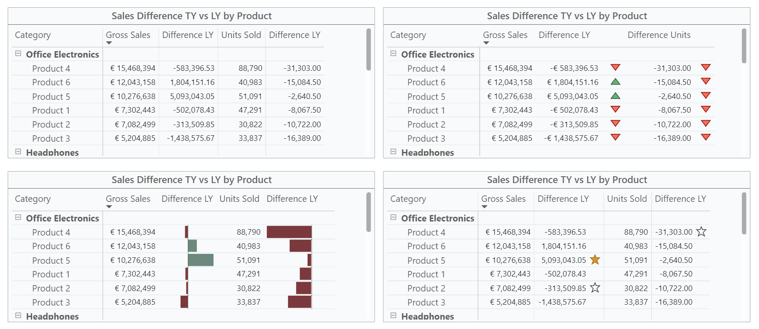
Small changes – huge effect

Slide 21
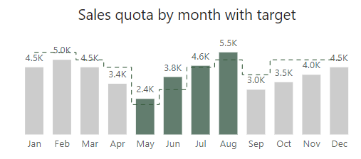
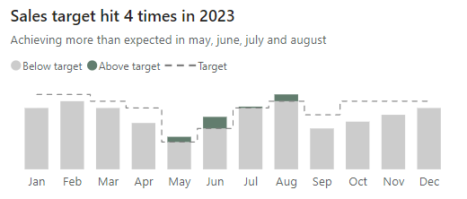
Adding Context
Legend & Colour coding
Notes:
Don’t leave people guessing

Slide 22
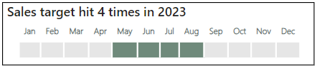
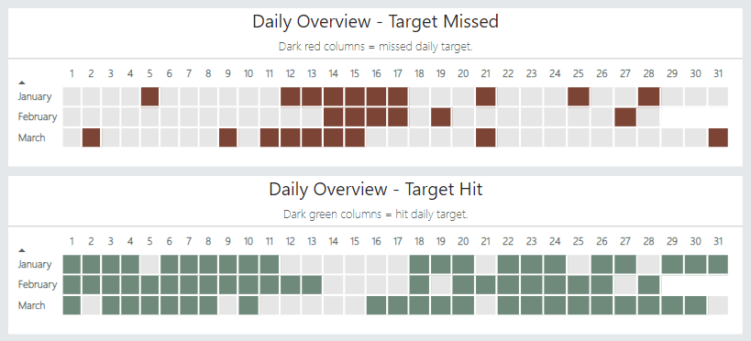
Simplify

Slide 23
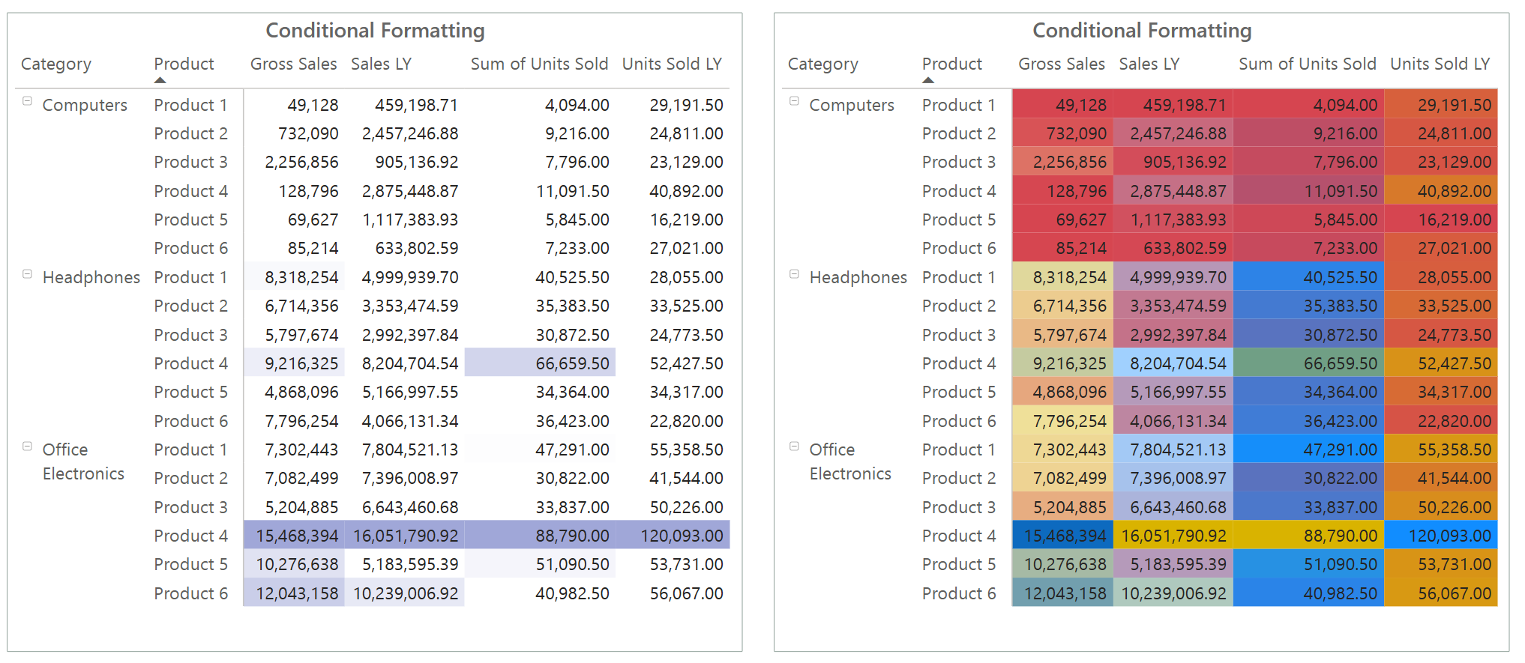
Simple & relevant

Slide 24

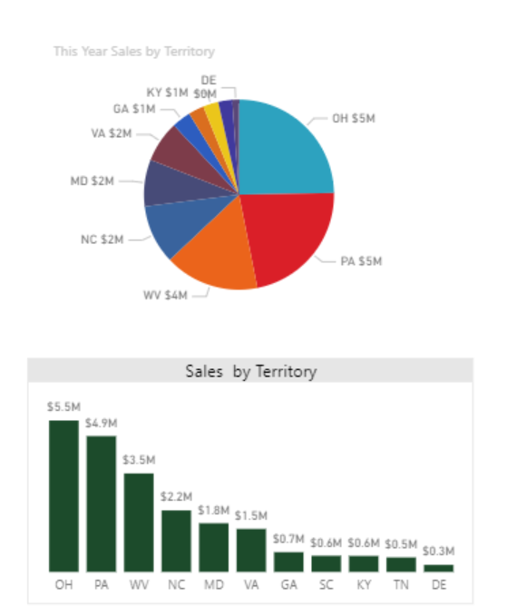
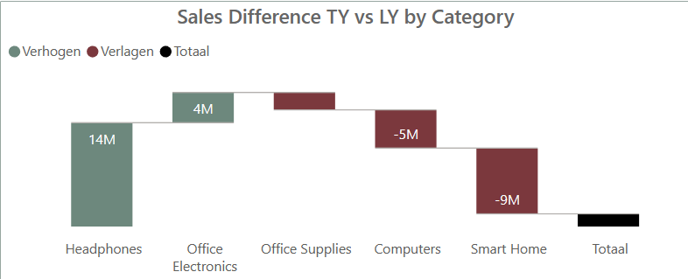
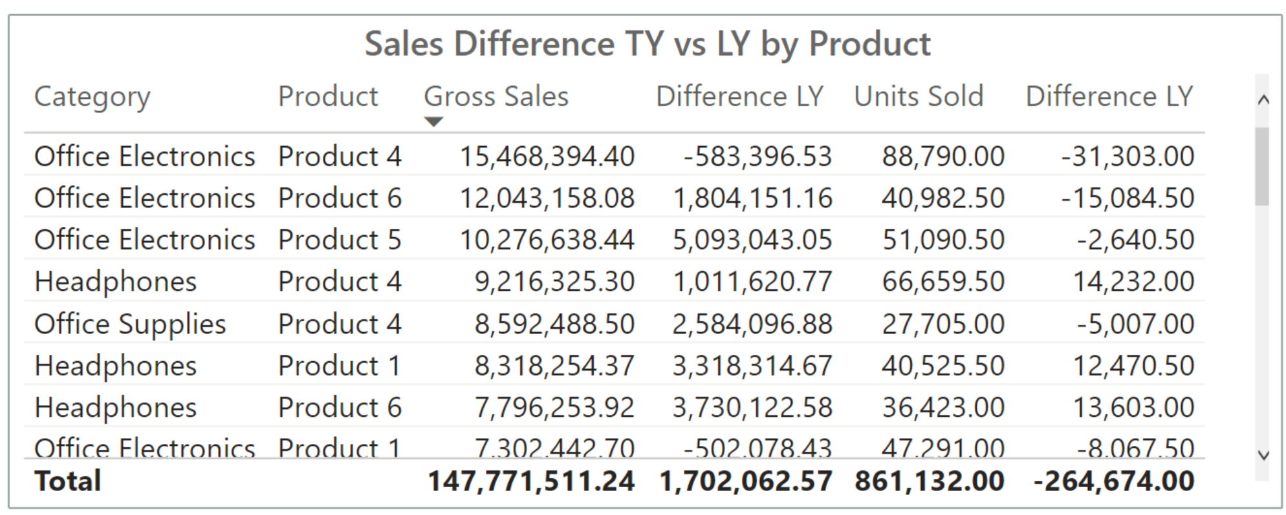
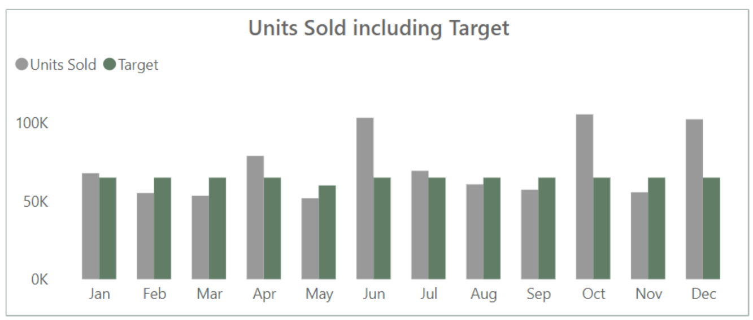
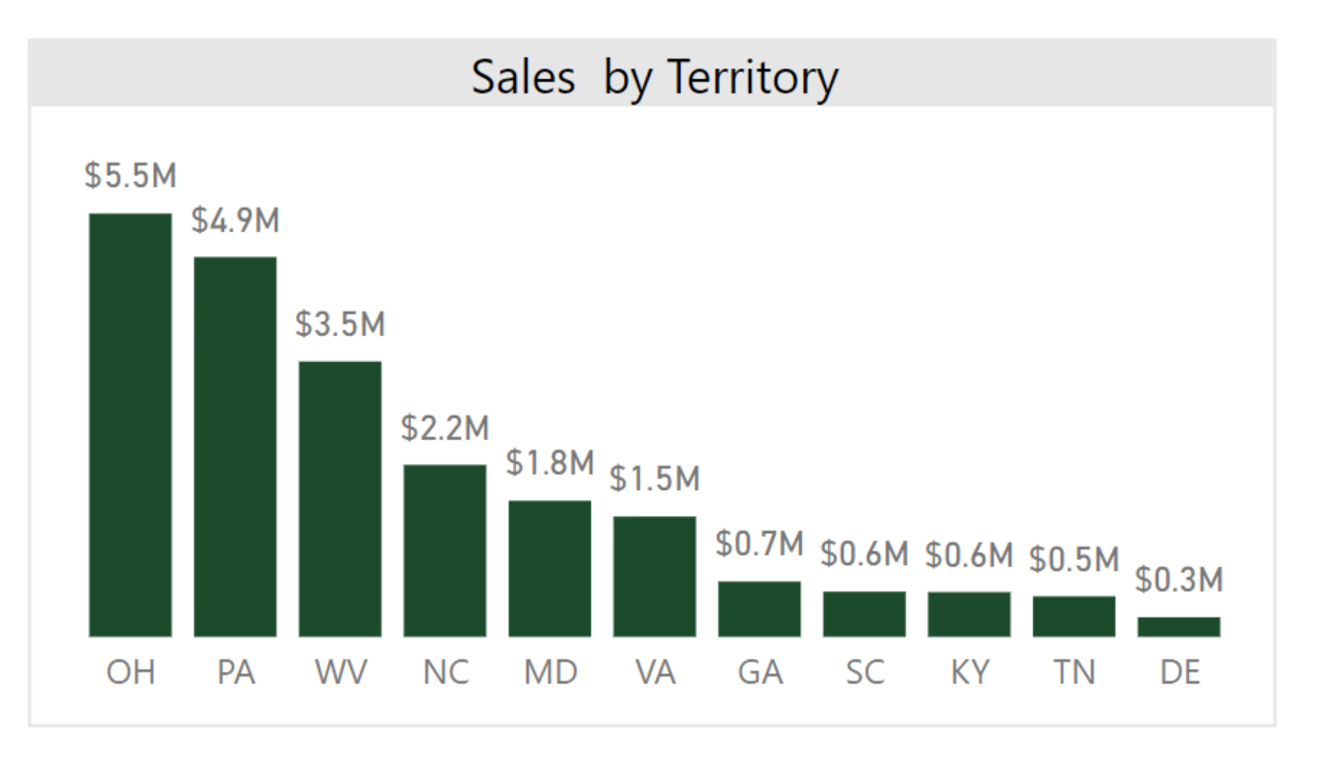
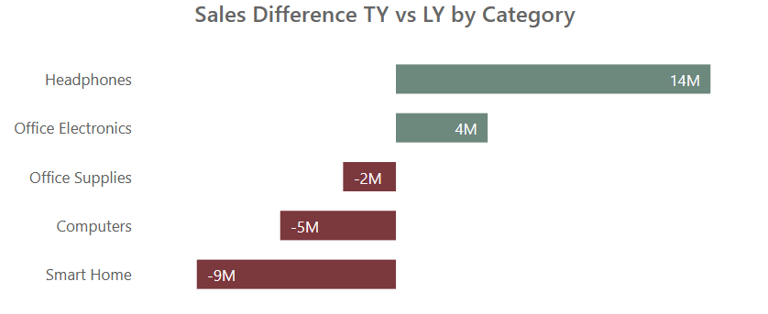
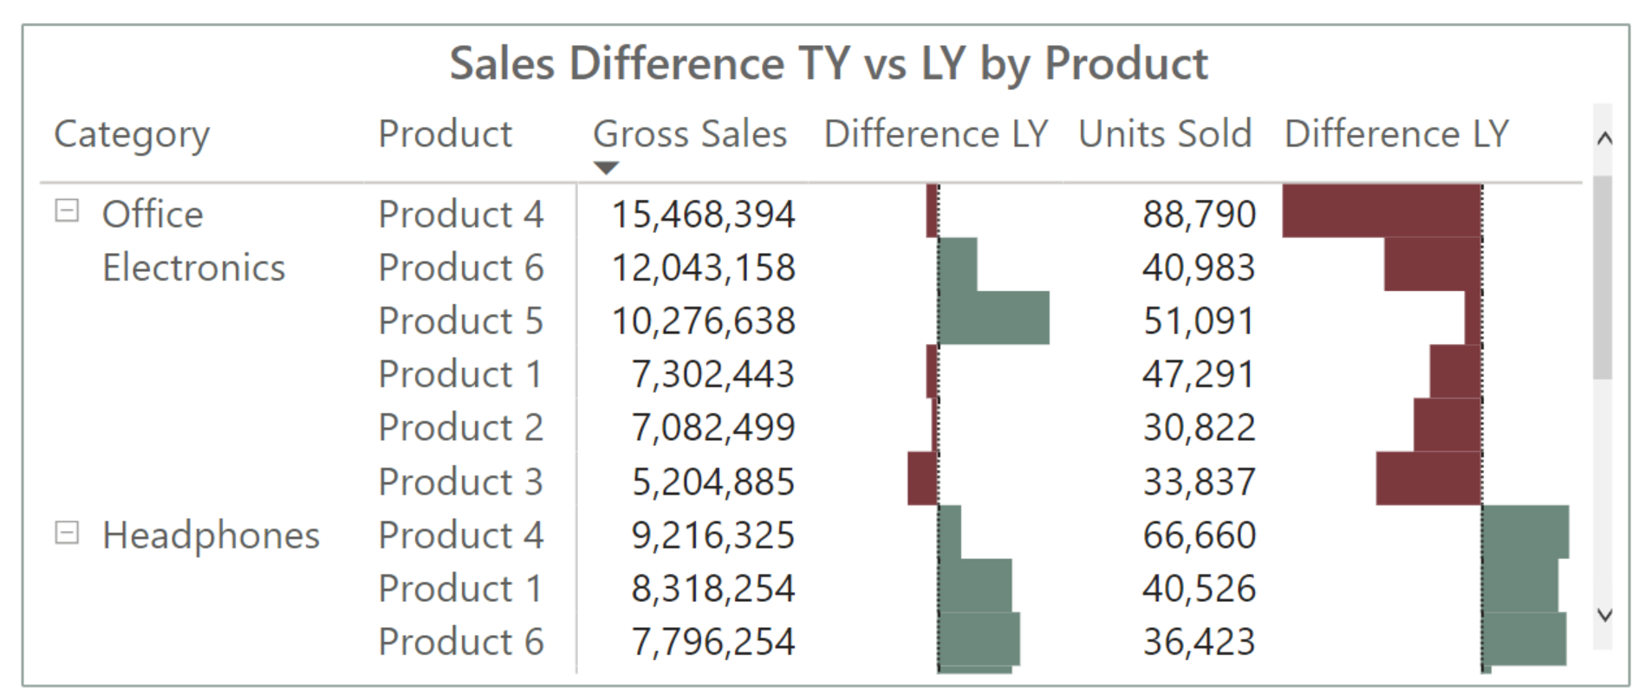
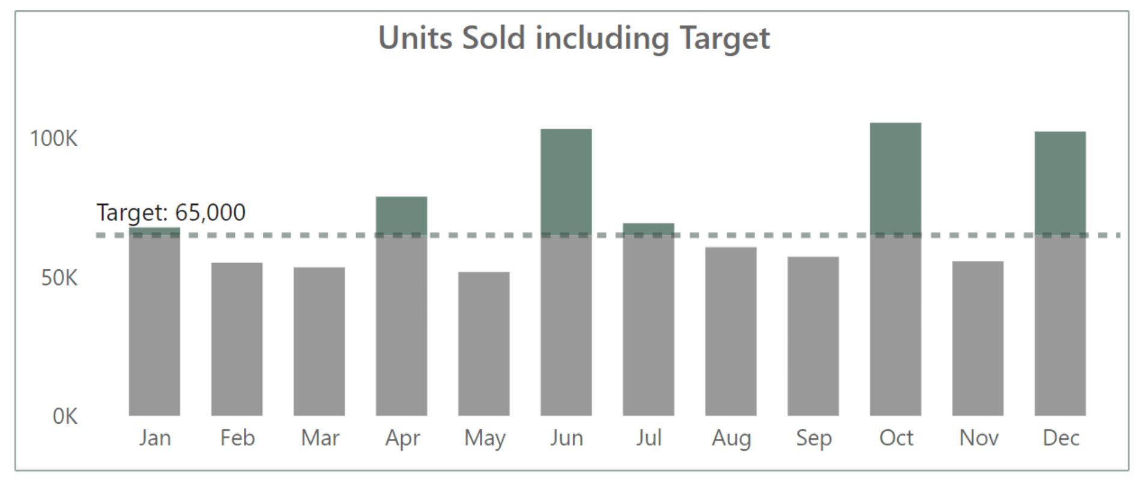
Check your visuals

Slide 25
Evaluate
Notes:
You are not designing for yourself

Slide 26
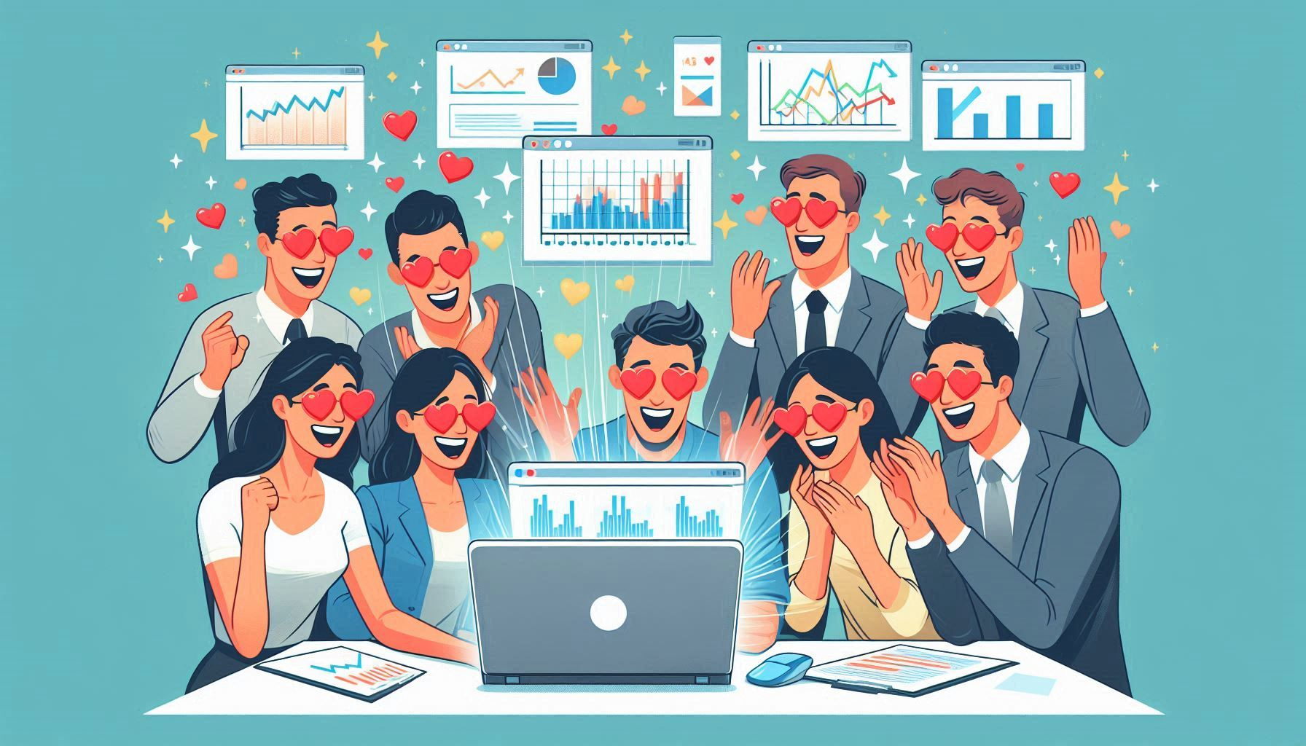
IT’S PERFECT!
Notes:
Especially when first report or long waiting for report, first reactions will be positive
Finally automatization
Finally press one button and get data
But
Only after time people know what they are missing

Slide 27

Continuous process
Involve the audience early on
Don’t stop directly after implementation
Evaluate with the actual audience

Slide 28
Assumptions
Don’t assume that what worked last time will work this time.
Proactive approach
How have processes changed?
Notes:
A team did not need any more assistance – maybe they need now
You need to be proactive on this, ask directly have processes changed, are decisions made differently.
Can you tell me how… what could further be improved

Slide 29
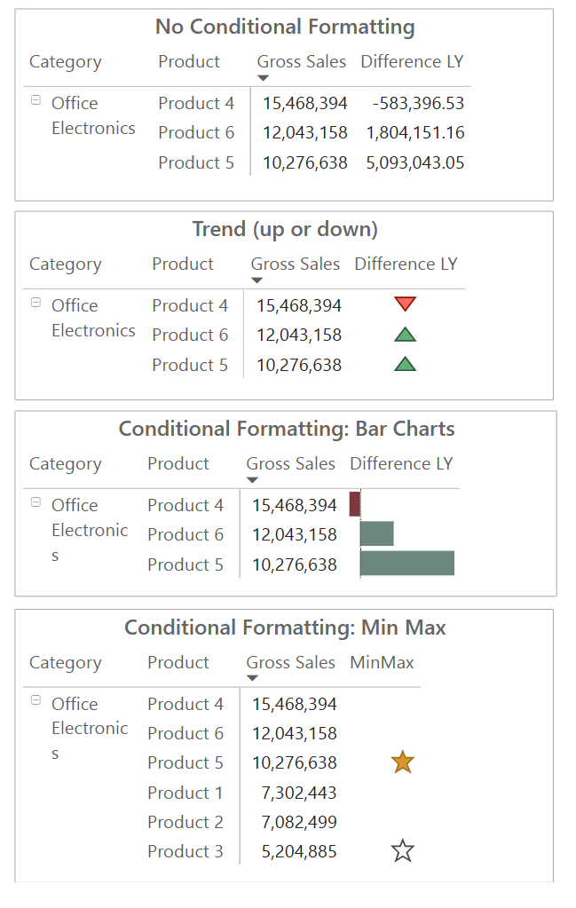
What if it doesn’t work?
Avoid adding unnecessary data, filters, or options.
Provide guidance.
Notes:
Don’t change tool
Different consultant.company
Don’t add more data or more filters just to find something
Try to show options – “I will search for it myself”
Proactive approach – investigate and provide guidance

Slide 30
Takeaway
Talk to the end user!
Understand the processes.
Guide the end-user.
Evaluate continuously!
Notes:
Talk to the end user! Direct communication ensures you understand their needs and challenges.Understand the processes. Knowing how the report fits into users' workflows helps identify areas for improvement.You can't fix wrong assumptions with design. Accurate understanding of user requirements is essential for effective report development.Evaluate continuously! Regular feedback and adjustments are key to maintaining a valuable and relevant report.

Slide 31
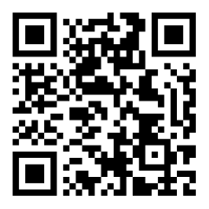
Contact
www.linkedin.com/in/valeriejunk/
porcubi
valeriejunk.bsky.social

